Slide 1
Introduction to ADO .NET Part 1
Raghu Prasad K S

Slide 2
Introduction
ActiveX Data Object (ADO)
ADO.NET provides consistent access to data sources such as SQL Server and XML, and to data sources exposed through OLE DB and ODBC. Data-sharing consumer applications can use ADO.NET to connect to these data sources and retrieve, handle, and update the data that they contain.
ADO.NET separates data access from data manipulation into discrete components that can be used separately or in tandem. ADO.NET includes .NET Framework data providers for connecting to a database, executing commands, and retrieving results. Those results are either processed directly, placed in an ADO.NET DataSet object in order to be exposed to the user in an ad hoc manner, combined with data from multiple sources, or passed between tiers. The DataSet object can also be used independently of a .NET Framework data provider to manage data local to the application or sourced from XML.

Slide 3
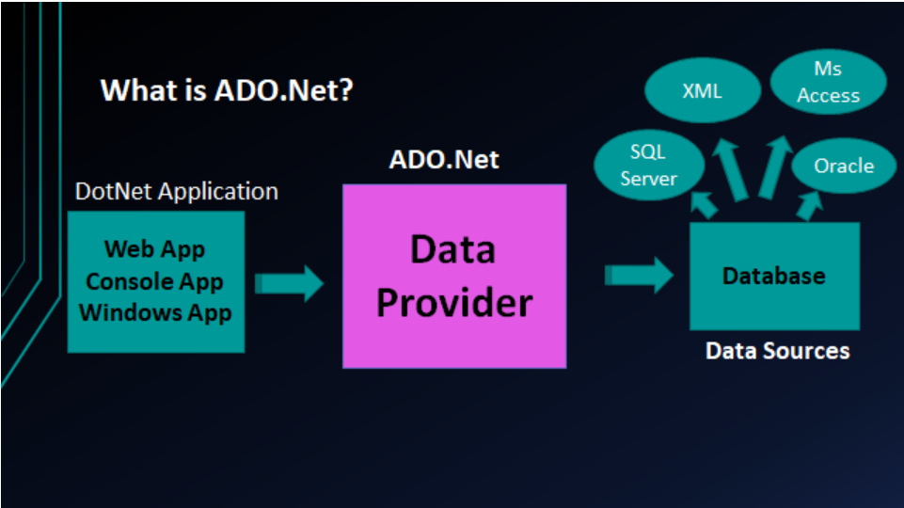
Introduction

Slide 4
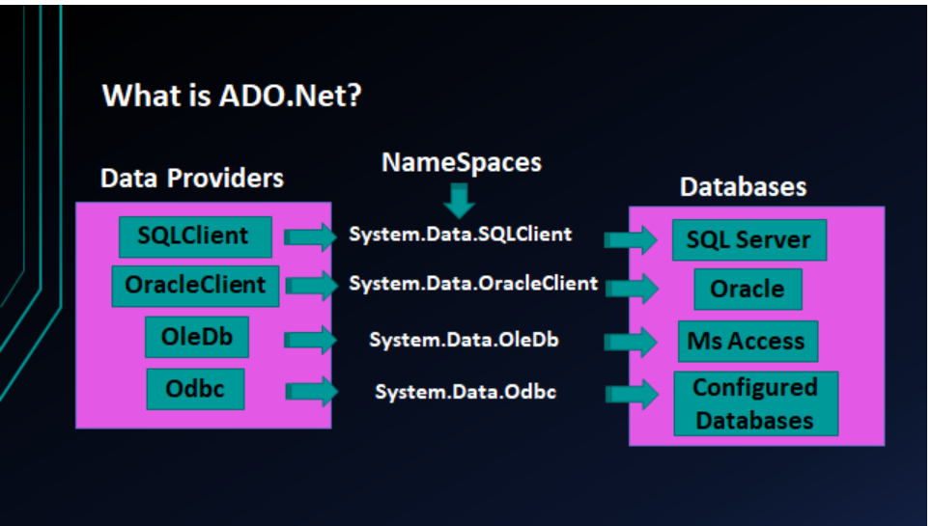
Providers

Slide 5
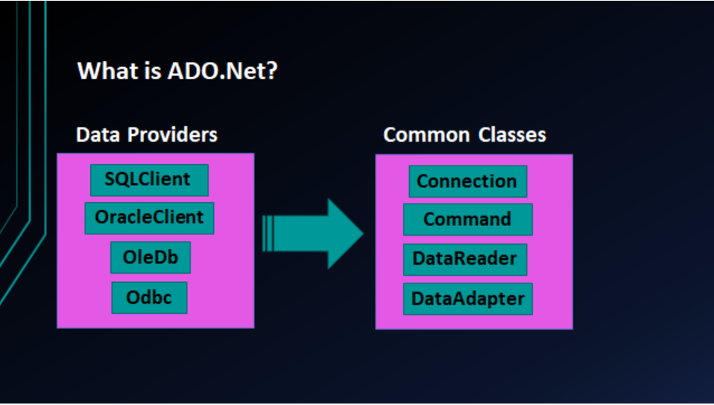
Common Classes

Slide 6
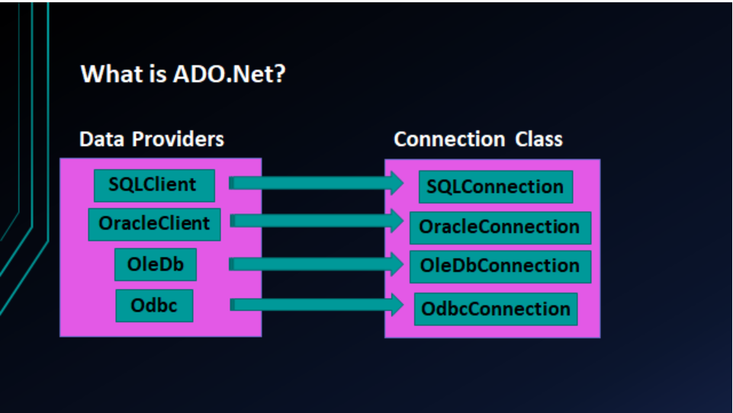
Connection Classes

